Slide 1

Nashville Police Calls Analysis
Ronald Pacheco

Slide 2
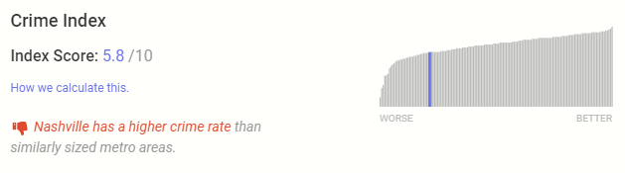
Is Nashville a Safe Place?
According to realestate.usnews.com, Nashville has a higher than average crime rate; however,
they do not show any data to back up their claim:
We will analyze the public data from the Nashville Police Department to corroborate this statement.

Slide 3
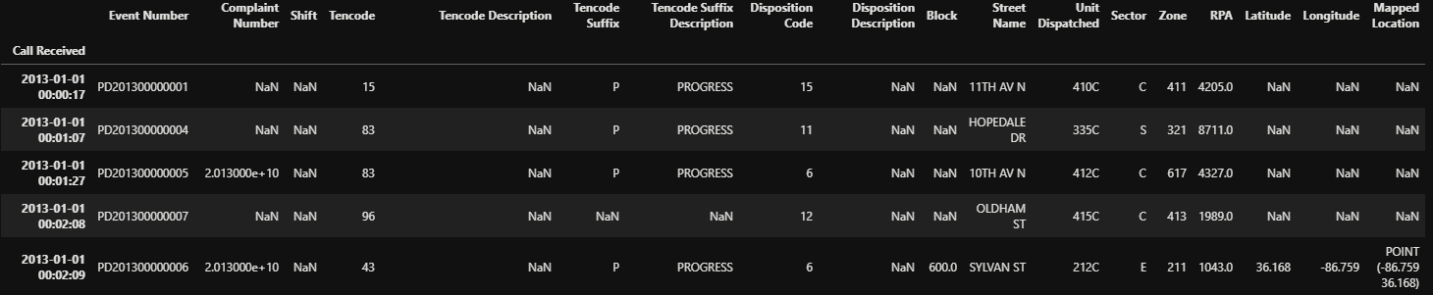
The Data
This data set includes details about emergency and non-emergency calls for Metro Nashville Police Department service received by the Emergency Communications Center from 2013 – Present.
Size: 8,281,717 rows X 18 columns:
Source: https://data.nashville.gov/Police/Metro-Nashville-Police-Department-Calls-for-Servic/kwnd-qrrm

Slide 4
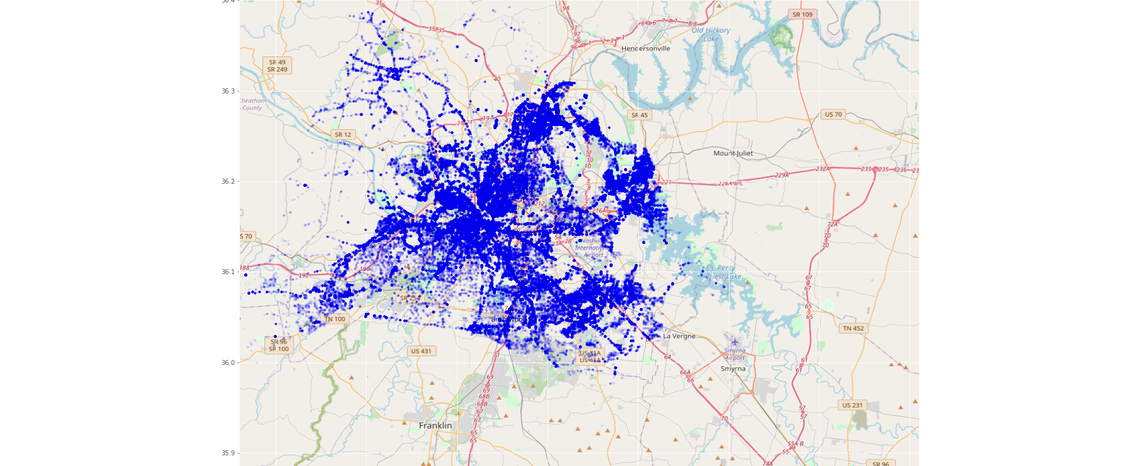
Call Location
Location of each call in data set overlayed on a map of Nashville

Slide 5
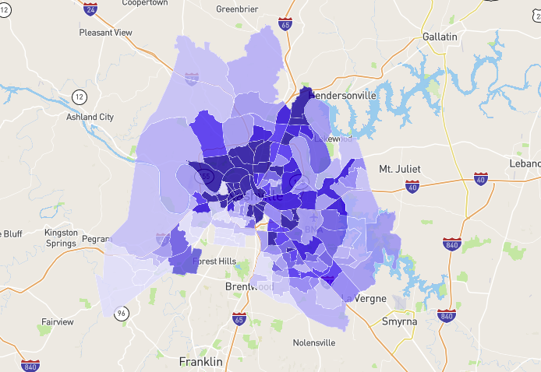

Crime Incident Map from NeighborhoodScout.com
For a Visual Comparison
of Similar Data…
NeighborhoodScout uses a relational database to associate crime incidences from all 18,000+ local law enforcement agencies in the U.S. to the specific local communities the agency covers, and hence in which community the crimes have occurred.
Date(s) & Update Frequency: Reflects 2019 calendar year; released from FBI in Sept. 2020 (latest available). Updated annually
https://www.neighborhoodscout.com/tn/nashville/crime

Slide 6
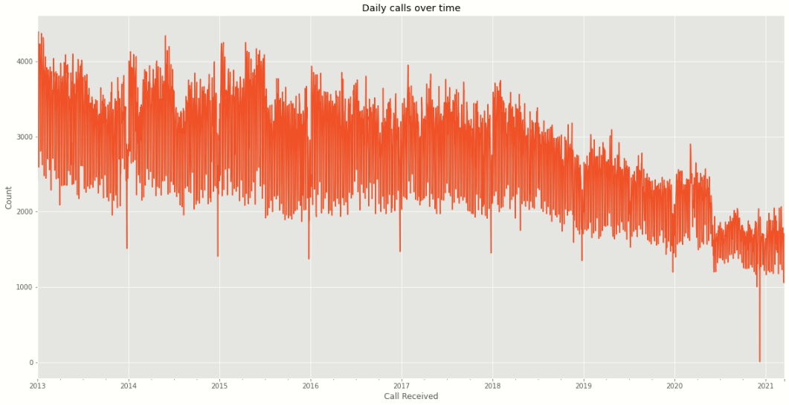
Trend Over Time
We can see how the number of daily calls to the police department has been steadily decreasing within the last few years.

Slide 7
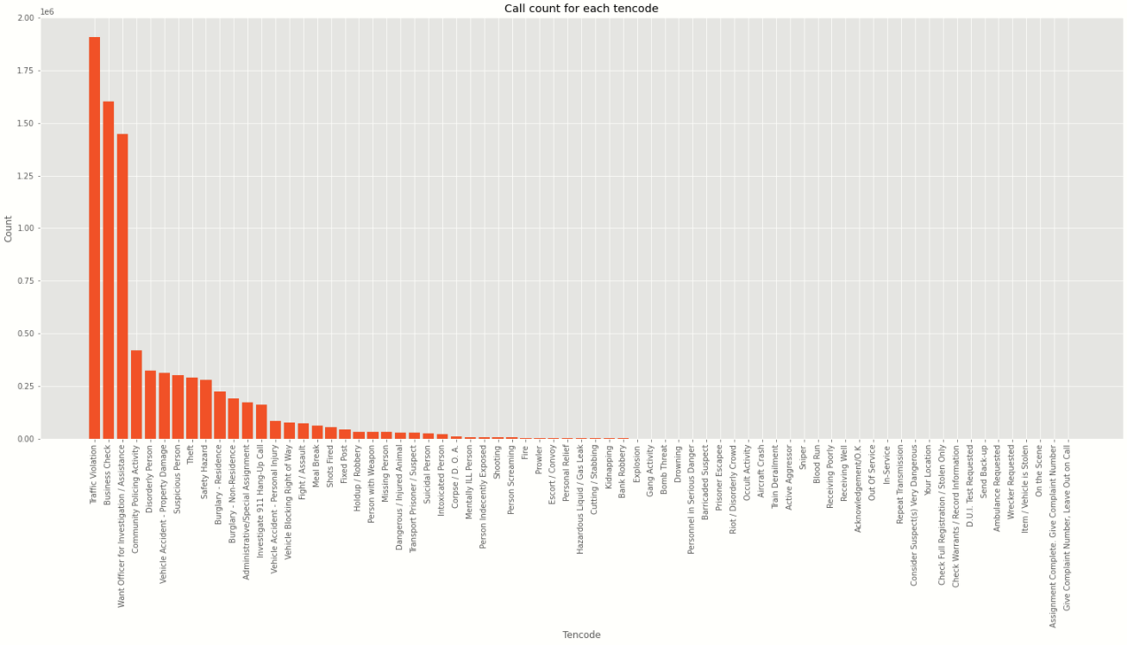
Number of Calls per Tencode
Most calls were due to traffic violations.
This might explain the decline with calls during 2020, since most people where at home during COVID-19.
Traffic Violations
Tencode: Abbreviated codes used to represent common phrases used to describe the call

Slide 8
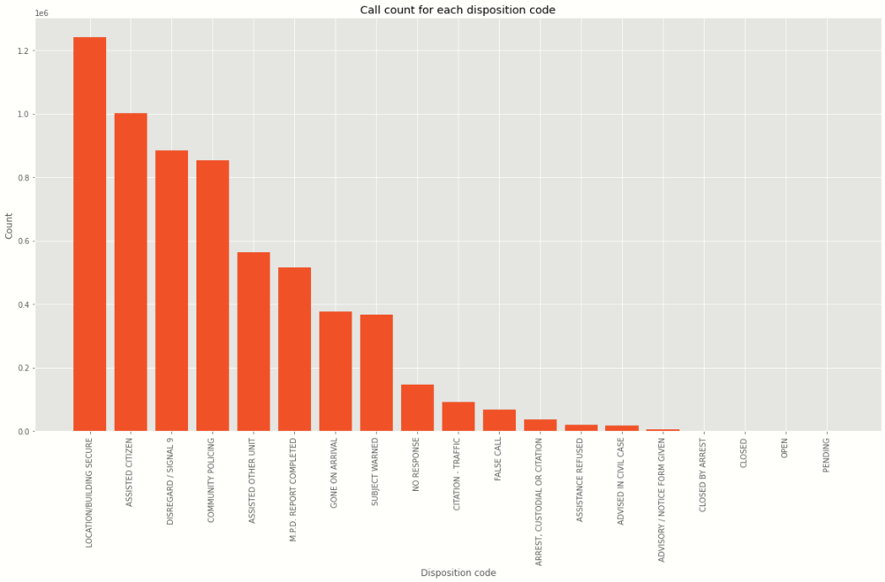
Number of Calls per Outcome
The codes used to describe the outcomes of most calls were:
'Securing Location/Building’
'Assisted Citizen’
'Disregard’.
Location/Building Secure
Disregard

Slide 9
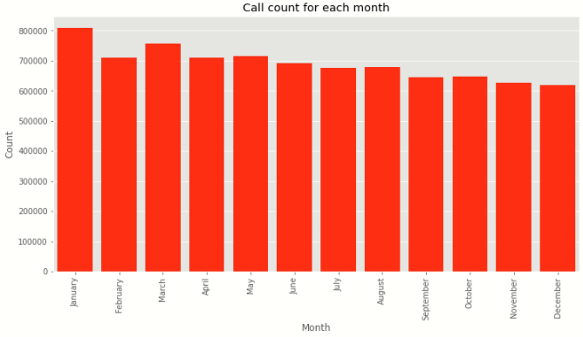
Number of Calls per Month
The month with the most calls overall is January.
Top three tencodes correspond to:
93 Traffic Violation
96 Business Check
43 Want Officer for Investigation / Assistance

Slide 10
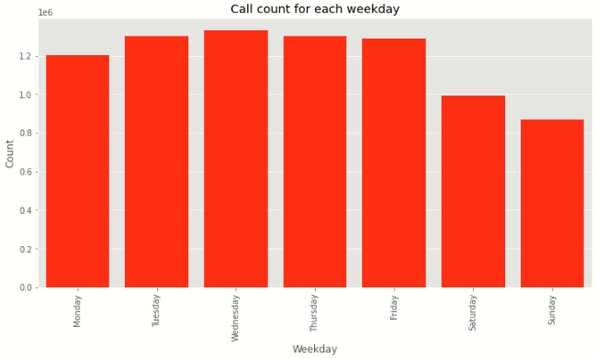
Number of Calls per Day
Sunday is the day with the least calls, followed by Saturday.
This might be because there are not as many people driving during Saturday and Sunday as there are during the week.

Slide 11
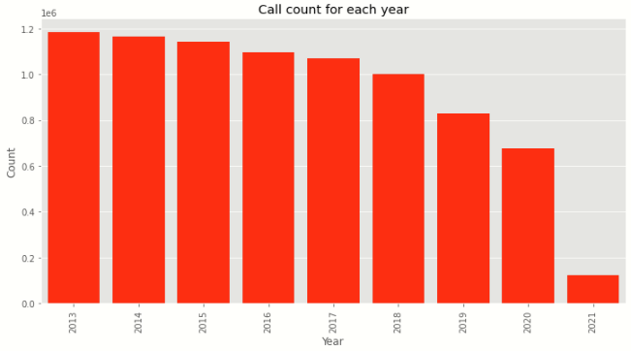
Number of Calls & Top Tencodes per Year
Years 2013 through 2018 have the same top tencodes:
Traffic Violation
Business Check
Want Officer for Investigation / Assistance
For 2019:
Business Check
Want Officer for Investigation / Assistance
Community Policing Activity
For 2020:
Business Check
Want Officer for Investigation / Assistance
Disorderly Person
So far, for 2021:
Business Check
Want Officer for Investigation / Assistance
Disorderly Person

Slide 12
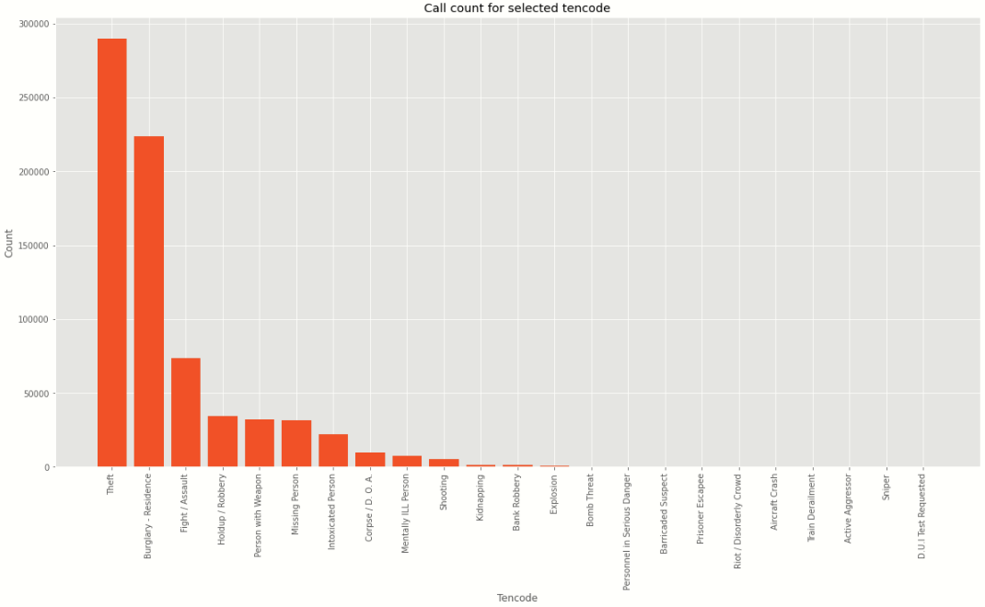
Call Count for Relevant Tencodes
Residential Burglary and Theft account for 2.7% and 3.5% of all calls, respectively.
Theft
Residential Burglary

Slide 13
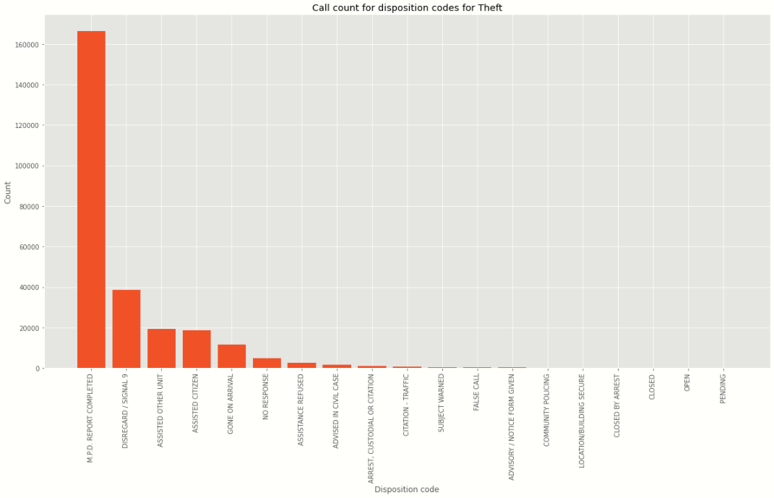
Outcome of Theft Calls
Most theft calls are closed out with a report.
We imagine most of the calls are regarding minor issues and there is not much the police can do about these.
Report Completed
Disregard

Slide 14
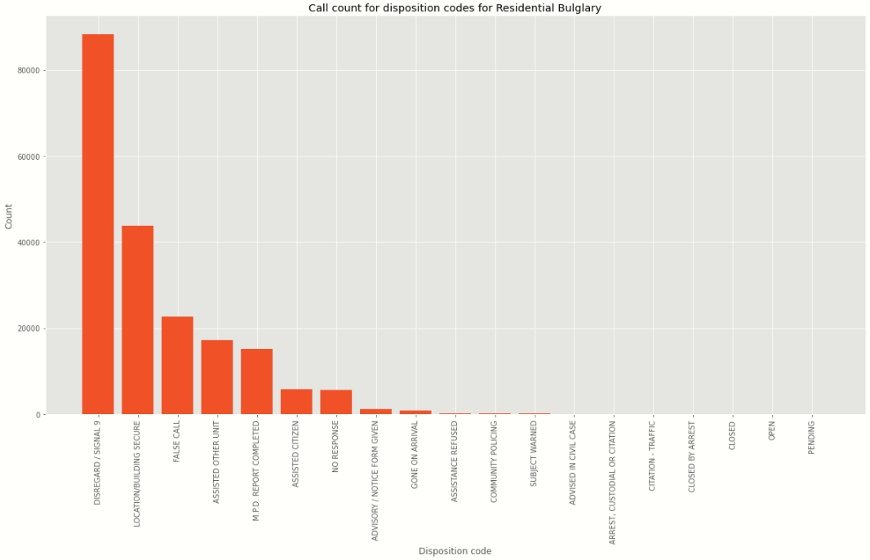
Outcome of residential burglary calls
Around half of the calls about residential burglaries are closed out as 'Disregard’.
Disregard

Slide 15
Future Research
Even though the documentation only gives 8 unique Sector codes, there are 108 different codes in the dataset. We would need to contact Nashville Police Department to understand what they mean.
There have been 9987 Dead on Arrival calls, it would be interesting to see how many of those are actual homicides.
A similar analysis of major metropolitan cities would give us a good benchmark to compare our results to.

Slide 16
Conclusions
There is a downward trend of number of police calls per year in Nashville.
Most calls are due to traffic violations. This might explain the decline on calls during 2020, since most people where at home during COVID-19.
Traffic Violations account for 23% of all calls, while Residential Burglary and Theft account for 2.7% and 3.5% respectively.
The claim “Nashville is a safe place” is relative to comparative data from other metropolitan areas. Due to this, it can neither be confirmed nor denied that Nashville is a safe place until future research is completed.

